Slide 1


CODEX MASTERCLASS

Slide 2
INTRO TO CODEX

Slide 3

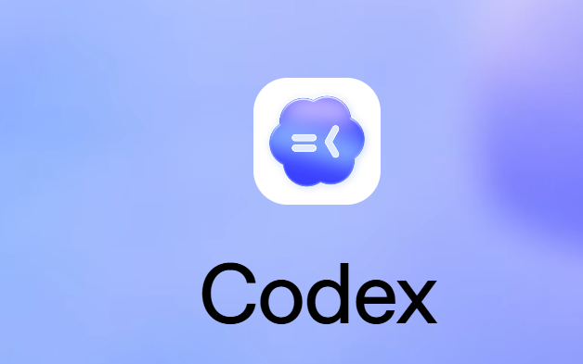
Into to Codex
Codex is a coding agent by OpenAI that helps you build and ship with AI.
It writes features, fixes bugs, and answers codebase questions, all running in parallel sandbox environments.
© All rights reserved for Dr. Ryan Ahmed @Stemplicity Inc.

Slide 4







Codex general capabilities
Document Creation
Data Analysis
Research & Synthesis
Word docs, spreadsheets, presentations, PDFs with professional formatting
Statistical analysis, visualization, data cleaning & transformation
Web research, transcript analysis, multi-source information gathering
© All rights reserved for Dr. Ryan Ahmed @Stemplicity Inc.
File Management
Code & Automation
Scheduled Tasks
Write scripts, build tools, automate repetitive workflows
Create recurring automated tasks that run on a set schedule
Organize folders, batch rename, process receipts, sort files
Codex uses more tokens than standard chat; think of it as OpenAI models (GPT) doing deep work, not quick answers.

Slide 5





Core Codex Coding Capabilities
Write Features
Fix Bugs
Answer Questions
Generate new features from natural language prompts
Identify and resolve issues across the codebase
Navigate and explain complex codebases
© All rights reserved for Dr. Ryan Ahmed @Stemplicity Inc.
Run Tests
Refactor Code
Write and execute tests, suggest edge cases
Improve structure, performance, and readability

Slide 6
CREATE BRANDED BUSINESS FLYERS WITH CODEX

Slide 7
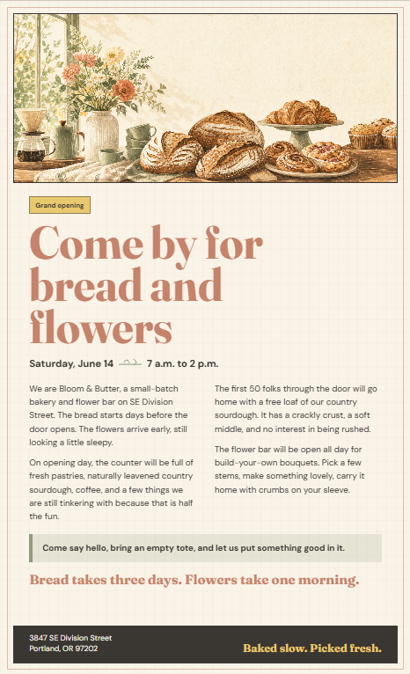
Project Overview
Bloom and Butter is a small-batch bakery and flower bar in Portland, Oregon. Founded by Maya Chen. Known for seasonal pastries, naturally leavened sourdough, and small floral arrangements you can grab with your morning coffee.
Brand Voice: Warm, unhurried, slightly playful but never cutesy. No corporate food language, no ALL CAPS, no emoji.
© All rights reserved for Dr. Ryan Ahmed @Stemplicity Inc.
Warm Cream
Soft Terracotta
Sage Green
Charcoal
Butter Yellow
#FAF3E8
#C4836A
#8B9E7E
#3A3632
#E8C96E
Sample Voice: "The cardamom brioche is back. We only make it when the rain starts again, which, lucky you, was Tuesday."

Slide 8



What You’ll Learn
Brand Voice Control
Image Generation
Give Codex a brand identity in your prompt and see it write in character
Generate a custom hero image with style and palette guidance
© All rights reserved for Dr. Ryan Ahmed @Stemplicity Inc.
Prompt Chaining
Visual Deliverables
Build prompts that reference outputs from previous steps
Get Codex to produce a polished, print-ready HTML flyer

Slide 9
The Two-Prompt Workflow
Prompt 1
Prompt 2
Hero Image
Flyer Content & Layout
Include brand info in the prompt
Describe the image style and palette
Generate a hero image
Write headline, body, CTA
Build the HTML flyer
Apply palette and typography
© All rights reserved for Dr. Ryan Ahmed @Stemplicity Inc.

Slide 10
What You’ll Build
assets/flyer_hero.png
On-brand hero image for the flyer
output/flyer_copy.md
Headline, body copy, and CTA in Maya's voice
© All rights reserved for Dr. Ryan Ahmed @Stemplicity Inc.
output/grand_opening_flyer.html
Print-ready flyer with image, copy, and layout

Slide 11
PRACTICE OPPORTUNITY

Slide 12

Practice Opportunity
Hound & Home is a dog grooming studio and boutique pet supply shop in Nashville, Tennessee. Founded by Marcus Cole, a former veterinary technician who wanted to build a grooming space that doesn't stress dogs out. The shop sells locally made dog treats, bandanas, and ceramic food bowls. Voice is friendly, straightforward, and a little goofy without being baby-talk.
Grand opening is Saturday, July 12th, 10 AM to 4 PM. The first 30 dogs get a free grooming session.
Tasks:
Write a prompt that includes Hound & Home's brand info (voice, palette, vibe) and generates a hero image that captures the warm, relaxed grooming studio
Write a prompt that references the hero image from prompt 1 and builds the full grand opening flyer with copy and layout.
© All rights reserved for Dr. Ryan Ahmed @Stemplicity Inc.

Slide 13
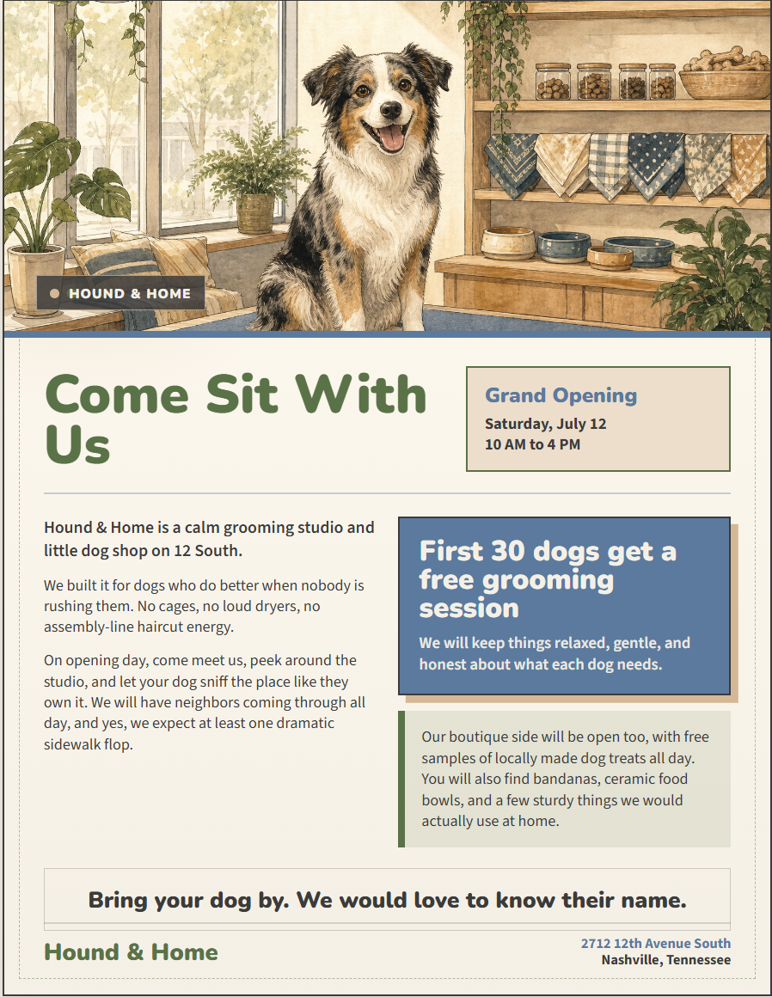
Practice Opportunity Solution
© All rights reserved for Dr. Ryan Ahmed @Stemplicity Inc.

Slide 14
PROMPT ENGINEERING

Slide 15
What is Prompt Engineering?
Prompt engineering is the practice of designing and optimizing text input to generative AI models to obtain desired responses.
It is the art of communicating with a generative AI model.
“Recommend a book.”
High-quality prompts guide the AI model to generate better outputs.
“Recommend a fiction book.”
© All rights reserved for Dr. Ryan Ahmed @Stemplicity Inc.
“Recommend a historical fiction book set in World War II.”

Slide 16
Prompt Components
Context: Set the scene, who is the AI, what's the situation?
Context:
You are a Smart Home Energy Advisor who helps homeowners reduce energy use.
Instruction: When given a household prompt, provide practical, prioritized advice.
Input: You will receive a question about energy usage or device efficiency.
Output: Respond with (1) A short, clear recommendation list (2-4 bullets), (2) One quick win that can be done today
Instruction: A clear statement of the desired goal.
Context
Input Data: The data or content to analyze.
Instruction
© All rights reserved for Dr. Ryan Ahmed @Stemplicity Inc.
Output Indicator: Define the expected format and structure
Input Data
Output Indicator

Slide 17
Prompting Essentials
Guide behaviour with System Prompt
Set the persona, rules, constraints and output format
Ask for reasoning (Chain of thought):
“explain your steps” or “show the calculation before the result” to build trust and transparency.
Add constraints & boundaries:
Word limits, style guides, or examples help the model aim correctly. “Explain in 3 bullet points, max 15 words each.”
Iterate and refine
The first draft is rarely the final. Treat prompts like a conversation; tweak wording, add detail, narrow scope until the output clicks.
Anchor with examples (Few Shot Prompting):
Show the AI what “good” looks like. A sample answer, tone, or structure is worth paragraphs of instructions.
Structured Output
Request JSON, XML, or specific formats
Force Model to Avoid Hallucination
“Don’t hallucinate, ground your results in the provided data. If data is missing, say ‘not enough info’ instead of guessing.”
© All rights reserved for Dr. Ryan Ahmed @Stemplicity Inc.

Slide 18
META PROMPTING

Slide 19
What is Meta-Prompting?
Meta-Prompting is the technique of using AI to help you write better prompts.
Instead of crafting the perfect prompt yourself, you ask the AI to generate, refine, or optimize prompts for you.
Without Meta-Prompting
With Meta-Prompting
Your prompt:
Do a SWOT analysis for Tesla.
Your meta-prompt:
“Write me the best prompt to perform a detailed, data-driven SWOT analysis for Tesla’s Model Y in the current competitive landscape.
© All rights reserved for Dr. Ryan Ahmed @Stemplicity Inc.
Result: Generic, unfocused summary missing key metrics and context.
Result: Structured, detailed prompt producing a detailed SWOT analysis.

Slide 20
Thank you!

